Slide 1
SIEM-Engineering
Date : May 9th, 2023
Notes:
Click to add notes

Slide 2
SIEM-Engineering
Splunk License Ingestion Trend

Slide 3
SIEM-Engineering
Splunk HYBRID BYOL

Slide 4
SIEM-Engineering
Cost

Slide 5
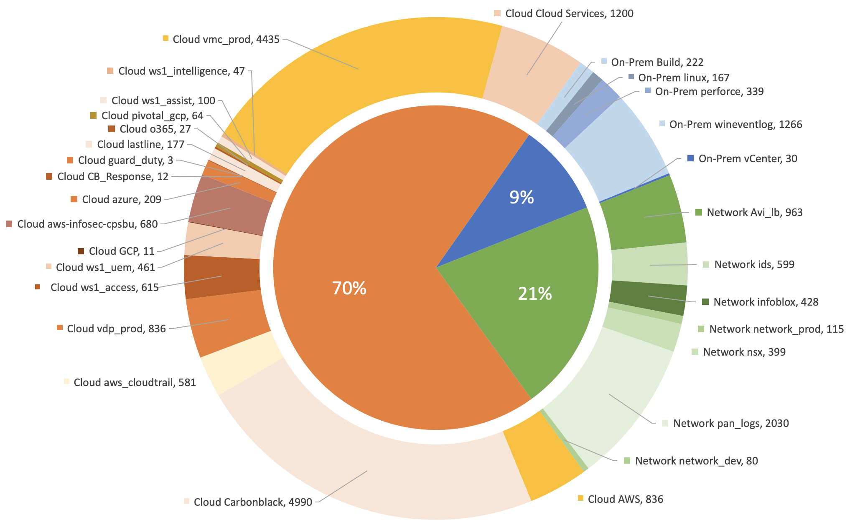
SIEM-Engineering
Log Data Sources

Slide 6
TOP Use Cases Comparison
SIEM-Engineering
Use Case | Description | Cribl Search | SnowFlake
Parsing | Easy/simple way to view a list of all fields and their top values present in any data set (KPI : Field Value Comparison with Splunk) | User Friendly to view all the fields and values | Complexity to view fields
Searches | Ability to perform efficient searches and analysis of security data to facilitate threat detection, incident response, and compliance requirements(KPI : Baseline Comparison with Splunk) Saved Searches Download the search Results Query language | Transition between Splunk and Cribl search re-enforce to make search easier, Easy to adopt | High barrier entry, Time & Cost of Adoption
Multi-cloud Support | Ability to Search data from AWS,GCP & Azure | Limited to AWS (Supportability to AWS and Azure on Roadmap, Tentatively End of the Year) Federated Search Supportability | Multi-Cloud Support (AWS,Azure and GCP), Require huge amount of time for Pre-Processing
End User Activity | RBAC for SLES User Audit logs for SLES User Activity logs such login/logout Ability to search and share search results with other users | Ability to actively investigate audit logs | Complexity to investigate audit logs
Log Data Sources | Log Data source type Such as Events,Audit,Authentication | Ability to Search Splunk buckets without thawing | In Ability to Search Splunk buckets without thawing
Alerts | • Alerts for Log Data ingestion interruptions • Alerts to be created that run on a schedule, the output of these should be able to be sent via email/ have Slack integrations / be able to be forwarded to Splunk | Ability to Send Alert directly to Splunk using HEC. | Dependency on Splunk DB connect Add-on

Slide 7
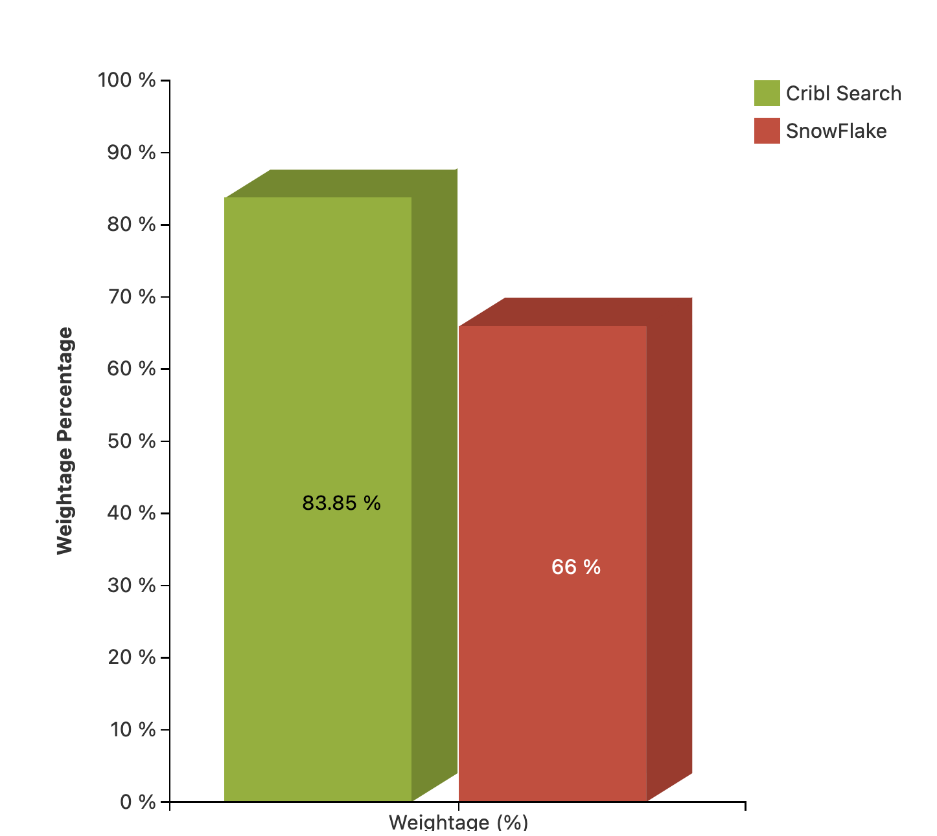
SIEM-Engineering
Summary
SnowFlake | Cribl Search
Data Ingestion and Pre-Processing is a Challenge | Support Federation Searches, Data ingestion not required
Data Searchability is High barrier entry, Time & Cost of Adoption | Splunk and Cribl search re-enforce to make search easier, Easy to adopt
Complexity to view data fields | User Friendly to view all the fields and values
Significant delay in getting large output Results in Snowflake UI | Search frequency is acceptable
Syslog data requires complex processors | Syslog data is auto-parsed
Based on the workshop sessions,use cases and inputs from Threat Management team, Cribl Cloud Search is the preferred Solution for Data lake.

Slide 8
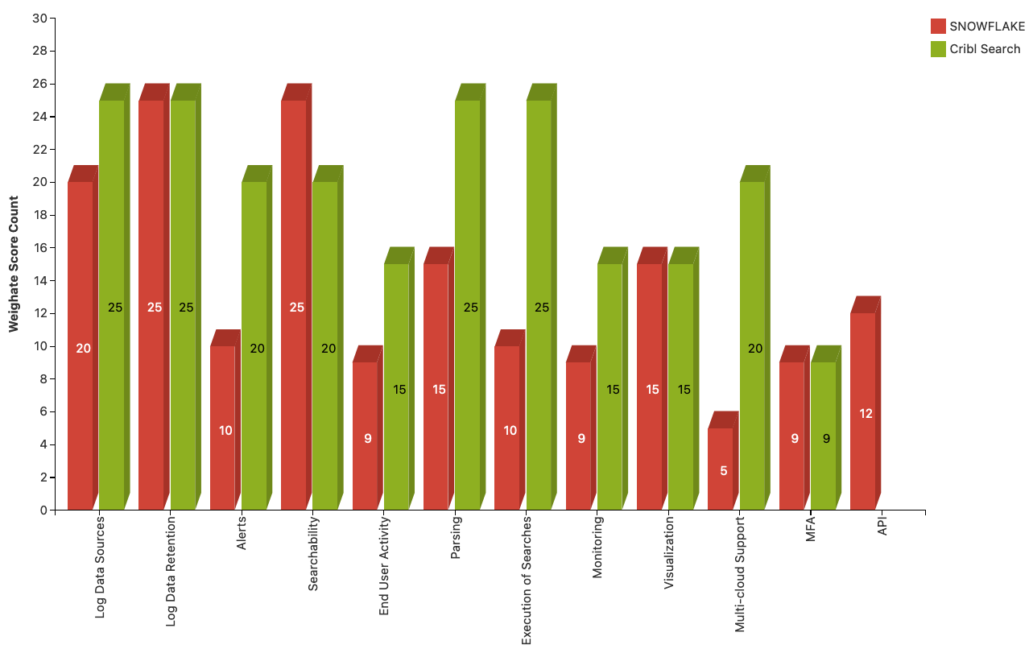
SIEM-Engineering
SLES Use Case Comparison

Slide 9
Thank You
Notes:
Click to add notes

